Slide 1
Decoloration of water contaminated by dyes using non-thermal plasma
Tomasz Izdebski
Mirosaław Dors
Jerzy Mizeraczyk

Slide 2
Motivation
AC discharge with phenol makes first order reaction
Methylene blue (MB) commonly used for AOTs
MB oxidation depends on the initial concentration and temperature, BUT does it depend on the reactor configuration?
Notes:
Several research papers proposed that ac water discharge phenol is first order reaction
Aim of my work is to study the mechanism of methylene blue degradation under such discharge and if it is influenced by reactor configuration
There are several probes used for studying AOTs. Most frequently phenol and Methylene blue are used. So, they work as standard organic pollutants alowing comparison between different oxidation technologies including those using electrical discharges
Studying chemical kinetics induced by electrical discharges is very important for modelling. Profesor Paradisi told us more about this on Monday.
Some researchers found dependency of MB reaction order on the initial concentration and of the temperature. With this work we wanted to check if single change in reactor configuration also influences the reaction order

Slide 3
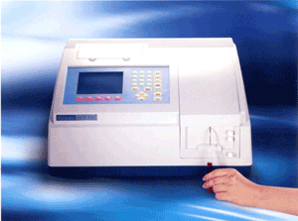
Experimental setup
Solution parameters:
Methylene blue concentration 4 ppm
pH 7
Temp. 22⁰ C
No flow system
Volume 20 ml
Diagnostics:
Metertech UV-VIS SP-8100 spectrophotometer
Notes:
In this work we used Methylene blue of low concentration in distilled water which was closed in small reactor. Changes in MB concentration caused by plasma was diagnosed with a spectrometer in UV and visible range. The solution parameters were as fallows:

Slide 4
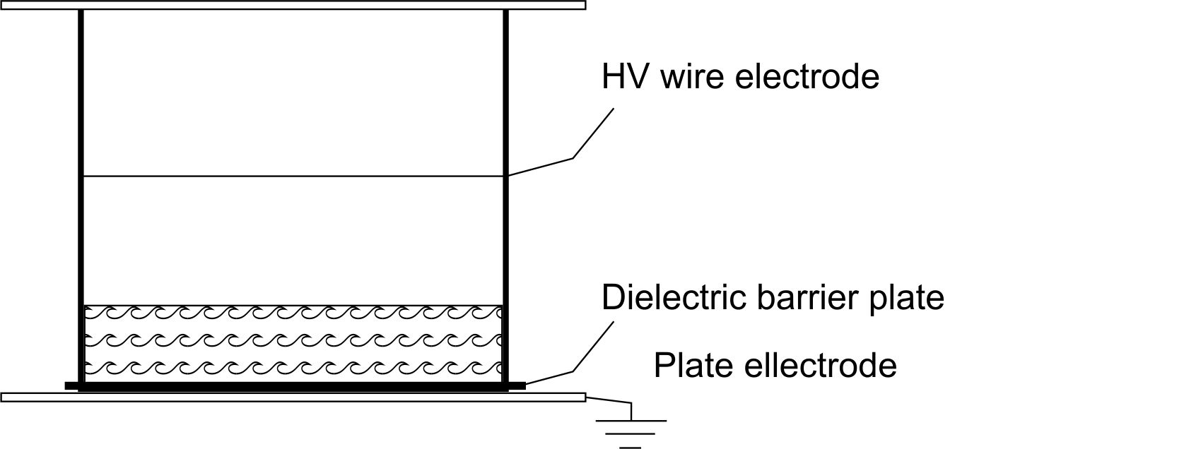
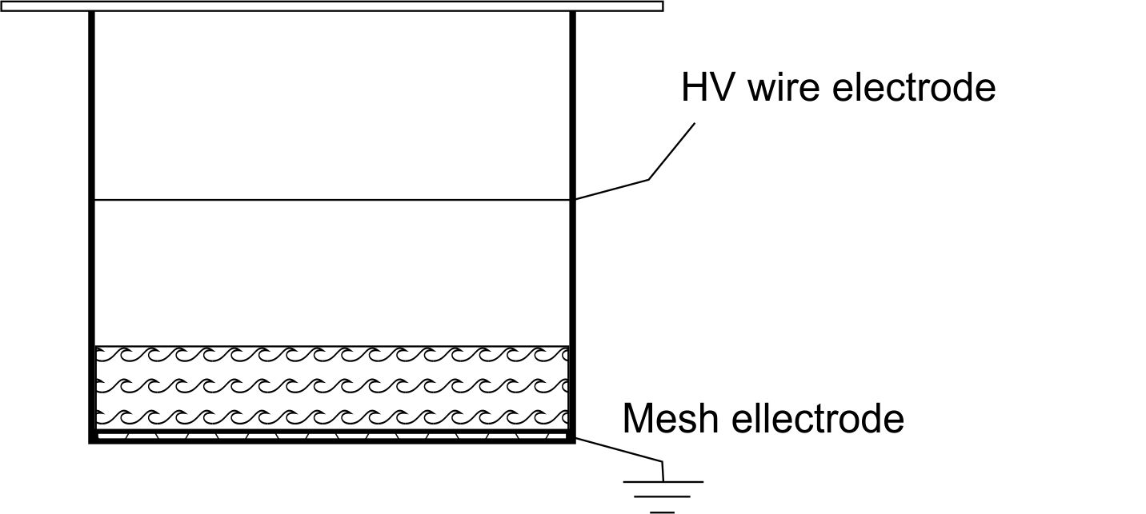
Experimental setup
Reactor parameters:
Cylinder, PMMA (Plexiglass)
Diameter 50 mm, 45 mm high
Gap between water and high voltage electrode 10 mm
Platinum wire, φ 0,2 mm
Dielectric barrier PMMA, 1 mm, ε=3-3,7
Stainless steel plate and mesh electrode.
Air, 0.1 MPa
Air, 0.1 MPa
Wire-plate-dielectric configuration
Wire-mesh-dielectric configuration
Notes:
Reactor was made of plexiglass and it was a cylinder of a few centimeters closed from both ends. Corona discharge was generated in air at atmospheric pressure between a platinum wire and solution surface. The gap between the wire and the solution was 10 mm. In the first configuration, grounded electrode was separated from the solution by plexiglass barrier, whereas in the scond configuration grounded electrode was immersed in the aquous phase.

Slide 5
Experimental setup
Power supply:
28 kV AC
Frequency 6 kHz
Discharge power 2.2 ± 0.2 W
Notes:
Corona discharge was generated using AC sinusoidal voltage of 28 kV and frequency 6 kHz. Averaged discharge power measured from Lissajous curves was about 2.2 W and was kept constant in both reactor configurations.

Slide 6
Results
Decoloration process:
First order reaction in wire-dielectric-plate configuration
Zero order reaction observed in wire- mesh-dielectric configuration
Reactor 1 wire - mesh-dielectric configuration
Reactor 2 wire -dielectric-plate configuration
Notes:
As for results, I have found that in spite of keeping initial concentration and the discharge power at the same value, Methylene blue is oxidized in different rate in both reactors. In the case of reactor with grounded electrode placed in the sulotion then the MB was oxidized in the zero-order reaction. The zero-order reactions were also observed in gliding discharge reactors as the first kinetic step for concentrated solutions {Prof. Brisset}. When grounded electrode was separated from the solution by dielectric barrier, the MB oxidation follows the first-order kinetics. So, very simple change in the reactor configurations caused serious change in the chemical kinetics concerning oxidation of MB.

Slide 7
Results
Reactor type | Initial conc. (mg/l) | k(min⁻¹)
Wire-mesh-dielectric reactor | 4 | k₀=0,065
Wire-dielectric-plate reactor | 4 | k₁=0,021
Point-point reactor with air bubbles [Benetoli et al. J. Braz. Chem. Soc., Vol. 22, No. 9, 1669-1678, 2011] | 20 | k₁= 0,0226
Underwater 6 needle-cylinder with oxygen bubbles [Magureanu et al. Plasma Chem. Proc. 2008] | 50 - 150 | k₁= 0,109-0,096
Wire-dielectric-plate reactor [Paradisi et al. Eur. Phys. J. Appl. Phys 2011] | Phenol: 9,4 – 70,5 | k₁= 0,06-0,012
Notes:
When we compare my results with those obtained by other researchers in other reactors we see that zero-order reaction is rather an exeption. Mostly first-order kinetics were observed. Benetoli found very similar reaction rate constant as I did but starting from 5 times higher MB concentration and in the reactor with needle electrode instead of wire. On the other hand, analysis of results obtained by Dr. Magureanu shows one order higher reaction rate constants for not much higher initial concentrations. And just for comparison, here are results which Prof. Paradisi has got studynig phenol oxidation kinetics in the same reactor configuration as that I used.

Slide 8
Results
By-products at 205 nm
Notes:
Now the question is about by-products of the Methylene blue oxidation. It was not the aim of my work but I recorded some by-products when measuring absorption spectra in the UV range. Here you can see decrease of absorbance peak of methylene blue at 665 nm and 295 (?) nm during 60 minutes of processing with the AC corona discharge. At the same time new peak at 205 nm appeared and it was growing during the experiment. This is an evidence of formation of colourless methylene blue processing by-products.

Slide 9
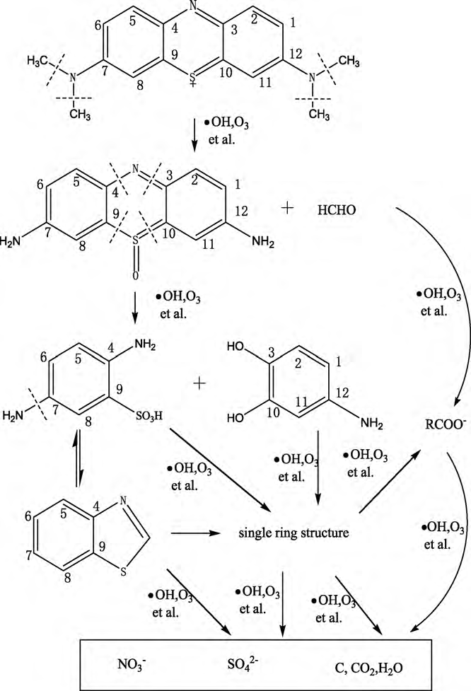
Methylene blue degradation
Colourless by-products
Intermediates with absorption at 205 nm
Degradation mechanism proposed by Huang et al. Chem Eng. J. , 2010
Notes:
I was not able to identify those by-products but accoridng to Huang they may be like shown in this scheme and they are all colourless. Since the corona discharge is generated in humid air and it develops towards the water solution it produces ozone and OH radicals. they attack Methylene blue molecules at positions of nitrogen atoms. This way first intermediate product and fornaldehyde are formed. In the next reaction ozone and OH radicals may cause separation of benzene rings. Next reactions may run in several pathways. Unfortunately, so far I have no proof for that mechanism of MB oxidation .

Slide 10
Conclusions
Methylene blue (MB) decoloration/oxidation in two reactor configuration was studied
Order of MB oxidation depends strongly on the reactor configuration
Zero –order – in wire-mesh-dielectric reactor there may be a free flow of oxidizing ions towards the grounded mesh of large area
First –order – in wire-dielectric-plate reactor flow of ions is disturbed by the dielectric barrier and then the reaction is governed by diffusion from the gas-liquid interface
Notes:
My investigation of the decoloration process of methylene blue solution in a AC corona discharge reactor led me to a conclusion that order of MB oxidation depends strongly on the reactor configuration, and not only on the initial concentration and tempeature as was observed by other researchers. This process may follow either zero-order or first-order kinetics. {i teraz możesz dalej czytać}

Slide 11
THANK YOU
FOR YOUR ATTENTION

